Slide 1
Chapter 3 Process Description and Control
The concept of process is fundamental to the structure of modern computer operating systems. Its evolution in analyzing problems of synchronization, deadlock, and scheduling in operating systems has been a major intellectual contribution of computer science.
Research Study, MIT Press, 1980

Slide 2
CS 345
Stalling’s Chapter | # | Project
1: Computer System Overview 2: Operating System Overview | 4 | P1: Shell
3: Process Description and Control 4: Threads | 4 | P2: Tasking
5: Concurrency: ME and Synchronization 6: Concurrency: Deadlock and Starvation | 6 | P3: Jurassic Park
7: Memory Management 8: Virtual memory | 6 | P4: Virtual Memory
9: Uniprocessor Scheduling 10: Multiprocessor and Real-Time Scheduling | 6 | P5: Scheduling
11: I/O Management and Disk Scheduling 12: File Management | 8 | P6: FAT
Student Presentations | 6

Slide 3
Chapter 3 Learning Objectives
Define the term process and explain the relationship between processes and process control blocks.
Explain the concept of a process state and discuss the state transitions the processes undergo.
List and describe the purpose of the data structures and data structure elements used by an OS to manage processes.
Assess the requirements for process control by the OS.
Understand the issues involved in the execution of OS code.
Assess the key security issues that relate to operation systems.
Describe the process management scheme for UNIX SVR4.

Slide 4
Questions…
What is a process?
When is a process created?
When is a process terminated?
What is a 2-state scheduling model?
What additional states are added with a 5-state model?
How does a suspended process differ from a blocked process?
What task variables are found in a Task Control Table?

Slide 5
1. What is a Process (or Task)?
Process
Sequence of instructions that executes
The entity that can be assigned to and executed on a processor
A unit of activity characterized by a single sequential thread of execution
Can be traced
Associated data needed by the program
Context
All information the operating system needs to manage the process
A current state and an associated set of system resources

Slide 6
OS Process Support?
Process
Assist the execution of a process
interleave the execution of several processes
maximize processor utilization
provide reasonable response time
Allocate resources to processes
fairness
avoid starvation / deadlock
Support interprocess activities
communication
user creation of processes

Slide 7
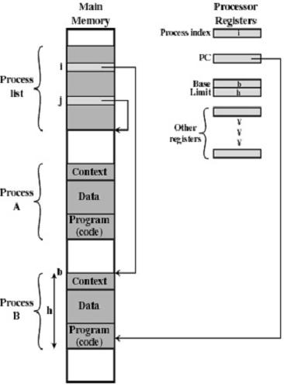
Process Implementation
Process
Process Control Blocks
Active
Context
Process

Slide 8
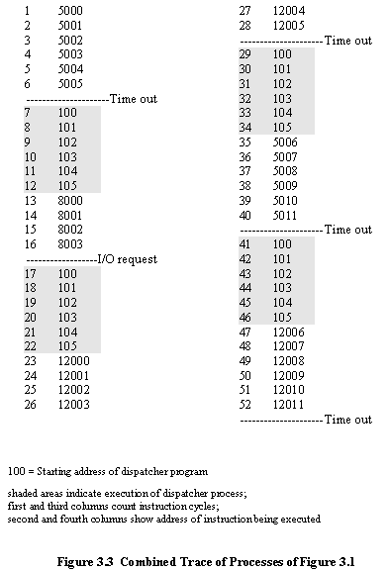
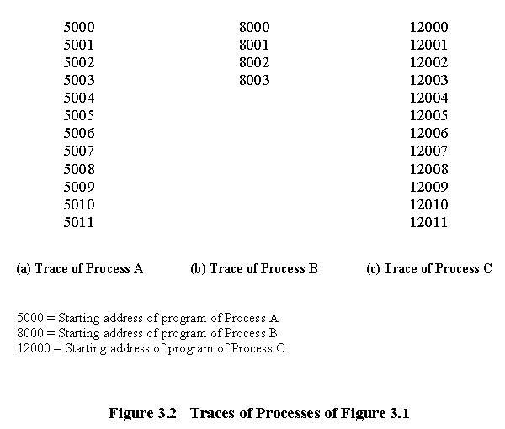
Process Trace
Process
An instruction trace reveals the overhead required to multi-process.

Slide 9
2. When is a Process Created?
Process Creation
Submission of a batch job
User logs on
Created to provide a service such as printing
Process creates another process
Modularity
Parallelism
Parent – child relationship
Deciding how to allocate the resources is a policy that is determined by the OS

Slide 10
Process Creation Decisions
Process Creation
Resource Allocation
Treat as a new process
Divide parent’s resources among children
Execution
child runs concurrently with parent
parent waits until some or all children terminate
Address Space
copy of parent
new program loaded into address space

Slide 11
Example: Unix Process Creation
Process Creation
A new process is created by the fork call
Child and parent are identical
child returns a 0
parent returns nonzero
Both parent and child execute next line
Often the child executes an exec
creates a brand new process in its space
Parent can execute a wait

Slide 12
Process Creation
Unix Example
fork() returns:
-1 = error
0 = child
>0 = parent
switch (child1 = fork())
{ case –1: printf("Can't fork");
exit(-1);
case 0: child1P(one2two, two2one); // child 1
exit(-2);
default: switch (child2 = fork()) // parent
{ case –1: printf("Can't fork");
exit(-1);
case 0: child2P(one2two, two2one);
exit(-3);
default: // Wait for child two
waitpid(child2, status2, options);
}
/* Wait for child one */
waitpid(child1, status1, options);
fflush(stdout);
}
waitpid() joins parent & child

Slide 13
Windows NT process creation
Process Creation
Windows subsystem has no understanding of parent / child relationship.
Process created by CreateProcess system call
Similar to fork-execve model
No process group concept
Child executes concurrently with parent
Loads a program into the address space of the child process
Processes are objects and have handles
Parent uses WaitForSingleObject() function to wait for child process termination.

Slide 14
Process Creation
Windows NT Example
// Now create the child process.
PROCESS_INFORMATION piProcInfo;
STARTUPINFO siStartInfo;
// Set up members of STARTUPINFO structure.
ZeroMemory( &siStartInfo, sizeof(STARTUPINFO) );
siStartInfo.cb = sizeof(STARTUPINFO);
// Create the child process.
CreateProcess(NULL,
program, // command line
NULL, // process security attributes
NULL, // primary thread security attributes
TRUE, // handles are inherited
0, // creation flags
NULL, // use parent's environment
NULL, // use parent's current directory
&siStartInfo, // STARTUPINFO pointer
&piProcInfo); // receives PROCESS_INFORMATION

Slide 15
3. When is a Process Terminated?
Process Termination
User logs off
Normal completion
Batch issues Halt
Time limit exceeded
Memory unavailable
Bounds violation
Protection error
example write to read-only file
Arithmetic error
Time overrun
event timeout
I/O failure
Invalid instruction
tried to execute data
Privileged instruction
Data misuse
Operating system intervention
such as when deadlock occurs
Parent terminates so child processes terminate
Parent request

Slide 16
Chapter 3 Learning Objectives
Define the term process and explain the relationship between processes and process control blocks.
Explain the concept of a process state and discuss the state transitions the processes undergo.
List and describe the purpose of the data structures and data structure elements used by an OS to manage processes.
Assess the requirements for process control by the OS.
Understand the issues involved in the execution of OS code.
Assess the key security issues that relate to operation systems.
Describe the process management scheme for UNIX SVR4.

Slide 17
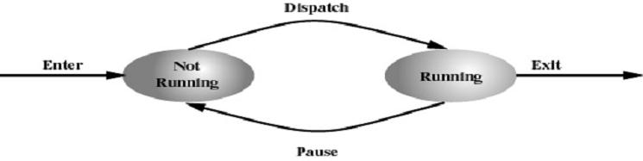
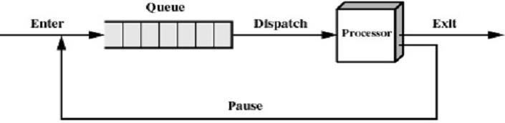
4. What is a 2-State Scheduling Model?
2-State Model
Process may be in one of two states
Running
Not-running

Slide 18
Two-state Model Problems
2-State Model
What does not-running mean?
Ready to execute?
Blocked?
Suspended?
Terminated?
Priority?
Scheduler/dispatcher cannot just select the process that has been in the queue the longest.
Challenge to make overall system as “efficient” and “fair” as possible.

Slide 19
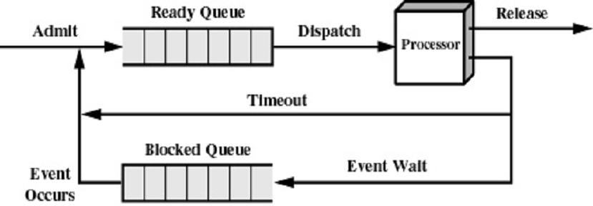
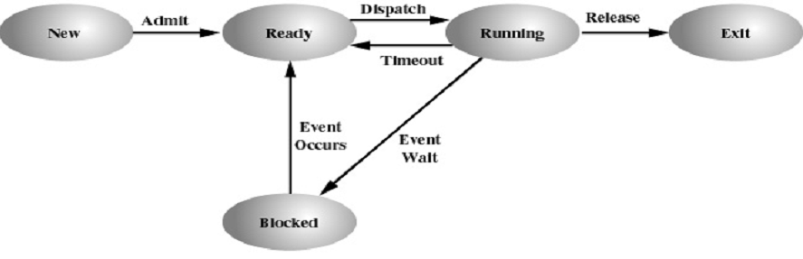
5. What is a 5-State Scheduling Model?
5-State Model

Slide 20
Five-state Model Transitions
5-State Model
Null → New: Process is created
New → Ready: O.S. is ready to
handle another process
Ready → Running: Select another
process to run
Running → Exit: Process has terminated
Running → Ready: End of time slice or higher-priority process is ready
Running → Blocked: Process is waiting for an event
Blocked → Ready: The event a process is waiting for has occurred, can continue
Ready → Exit: Process terminated by O.S. or parent
Blocked → Exit: Same reasons

Slide 21
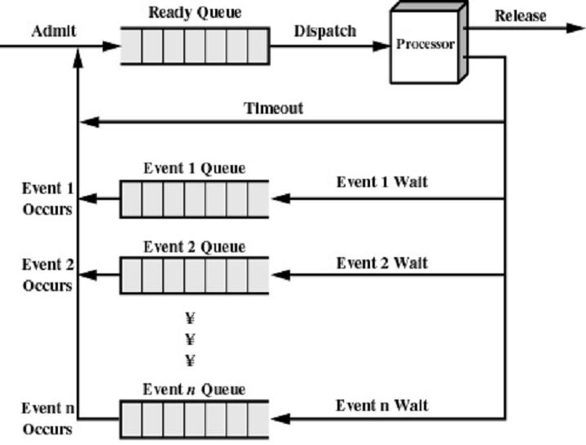
Multiple Blocked Queues
5-State Model

Slide 22
5-State Scheduler
P2 - Tasking
#define SWAP swapTask();
#define SEM_WAIT(s) semWait(s);
#define SEM_SIGNAL(s) semSignal(s);
#define SEM_TRYLOCK(s) semTryLock(s);
createTask()
dispatch()
killTask()
Ready
Queue
New
Running
Exit
swapTask()
semSignal()
semWait()
semTryLock()
Blocked
Queues

Slide 23
6. What is a Suspended Process?
Suspended Process
Processor is faster than I/O so all processes could be waiting for I/O
Swap these processes to disk to free up more memory
Blocked state becomes suspended state when swapped to disk
Two new states
Blocked, suspend
Ready, suspend

Slide 24
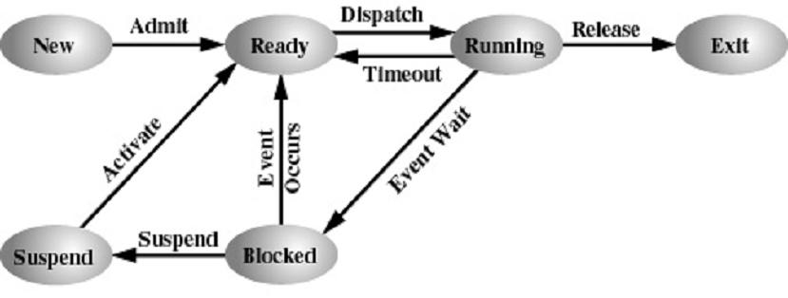
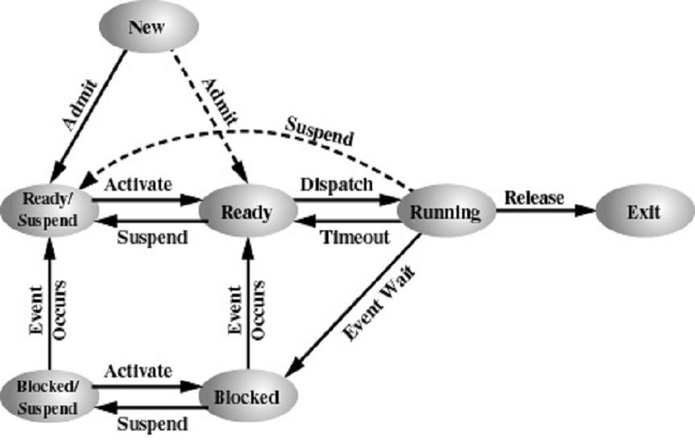
Suspended State Scheduling
Suspended Process
One Suspend State
Two Suspend State

Slide 25
Reasons for Process Suspension
Suspended Process
Swapping
The OS needs to release sufficient main memory to bring in a process that is ready to execute
Other OS reason
The OS may suspend a background or utility process or a process that is suspected of causing a problem
Interactive user request
A user may wish to suspend execution of a program for purposes of debugging or in connection with the use of a resource
Timing
A process may be executed periodically and may be suspended while waiting for the next time interval
Parent process request
A parent process may wish to suspend execution of a descendent to examine or modify the suspended process

Slide 26
Chapter 3 Learning Objectives
Define the term process and explain the relationship between processes and process control blocks.
Explain the concept of a process state and discuss the state transitions the processes undergo.
List and describe the purpose of the data structures and data structure elements used by an OS to manage processes.
Assess the requirements for process control by the OS.
Understand the issues involved in the execution of OS code.
Assess the key security issues that relate to operation systems.
Describe the process management scheme for UNIX SVR4.

Slide 27
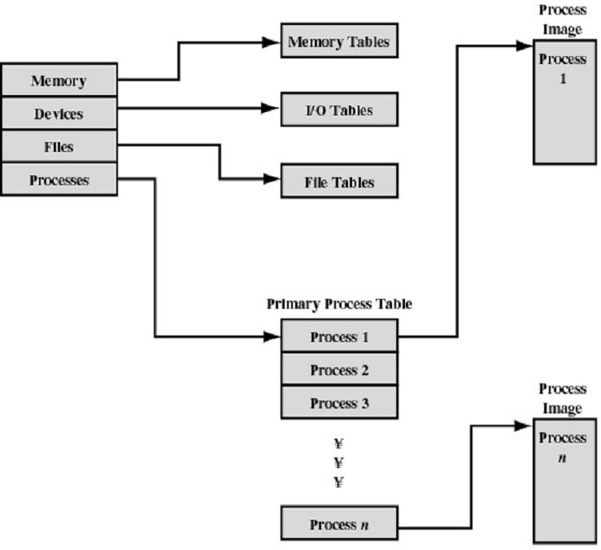
7. Operating System Control Tables
Control Tables

Slide 28
Control Tables
Control Tables
Memory Tables
Allocation of main memory to processes
Allocation of secondary memory to processes
Protection attributes for access to shared memory regions
Information needed to manage virtual memory
I/O device is available or assigned
Status of I/O operation
Location in main memory being used as the source or destination of the I/O transfer

Slide 29
Control Tables
Control Tables
File Tables
Existence of files
Location on secondary memory
Current Status
Attributes
Usually maintained by a file management system
Process Table
Process ID
Process state
Location in memory

Slide 30
Process Location
Control Tables
Process includes set of programs to be executed
Data locations for local and global variables
Any defined constants
Stack
Process Control Block (PCB)
Collection of attributes
Process image
Collection of program, data, stack, and attributes

Slide 31
Task Control Block (tcb)
P2 - Tasking
// task control block
typedef struct // task control block
{ char* name; // task name
int (*task)(int,char**); // task address
int state; // task state
int priority; // task priority (P2)
int argc; // task argument count (P1)
char** argv; // task argument pointers (P1)
int signal; // task signals (P1)
void (*sigContHandler)(void); // task mySIGCONT handler (P1)
void (*sigIntHandler)(void); // task mySIGINT handler (P1)
void (*sigKillHandler)(void); // task mySIGKILL handler (P1)
void (*sigTermHandler)(void); // task mySIGTERM handler (P1)
void (*sigTstpHandler)(void); // task mySIGTSTP handler (P1)
TID parent; // task parent
int RPT; // task root page table (P4)
int cdir; // task directory (P6)
Semaphore *event; // blocked task semaphore (P2)
void* stack; // task stack (P2)
jmp_buf context; // task context pointer (P2)
} TCB;

Slide 32


